Slide 1

STICHTING SETIA
For Christian education in Indonesia
Setia means faithful. We believe every child has a right to Christian education, in Indonesia too.

Slide 2
Children in Yogyakarta
Java
stichtingsetia.nl

Slide 3
About this project
In Yogyakarta, Setia helps children from struggling families to keep going to school.
stichtingsetia.nl

Slide 4
What we concretely need
A child in school for a year: € 1800
stichtingsetia.nl

Slide 5
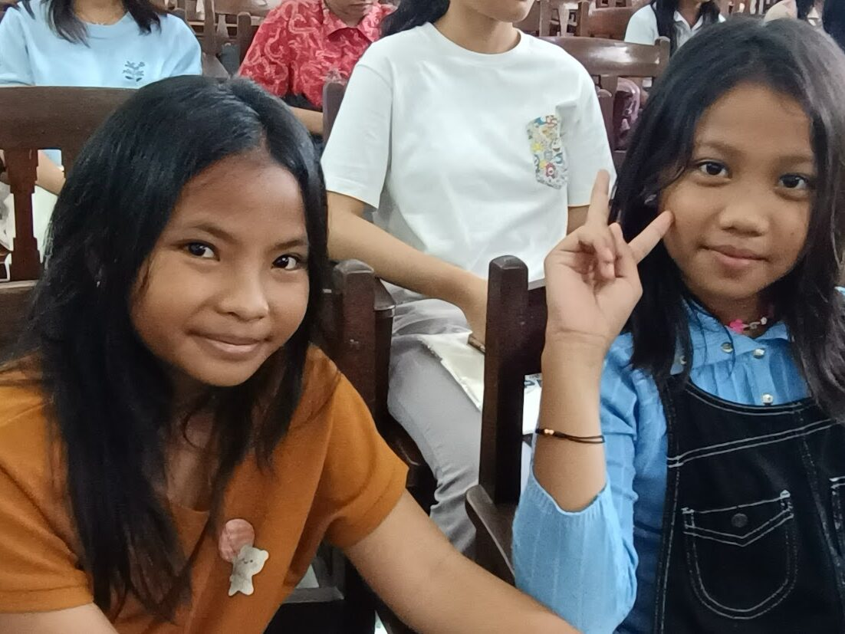
Children in Yogyakarta

Slide 6
Give to Christian education
IBAN: NL61 RABO 0321 4429 89
In the name of Stichting Setia, 't Harde
reference: project code J-25-01
Stichting Setia is a registered Dutch charity (ANBI).
stichtingsetia.nl

